Slide 1
IMDB Movie Analysis (Final Project-1)
Created by- Shweta Kushwaha

Slide 2
Project Description
In this project dataset provided is related to IMDB Movies. A potential problem to investigate could be: "What factors influence the success of a movie on IMDB?" Here, success can be defined by high IMDB ratings. The impact of this problem is significant for movie producers, directors, and investors who want to understand what makes a movie successful to make informed decisions in their future projects. In this project we required to access the data from IMDB and generate insights on the questions asked by the team.

Slide 3
Approach
Five 'Whys' Approach: This technique will help dig deeper into the problem. For instance, if you find that movies with higher budgets tend to have higher ratings, you can ask "Why?" repeatedly to uncover the root cause. Here's an example:
Q: "Why do movies with higher budgets tend to have higher ratings?"
A: They can afford better production quality.
Q: "Why does better production quality lead to higher ratings?"
A: It enhances the viewer's experience.
Q: "Why does an enhanced viewer experience lead to higher ratings?"
A: Viewers are more likely to rate a movie highly if they enjoyed watching it.
Q: "Why are viewers more likely to rate a movie highly if they enjoyed watching it?"
A: Positive experiences lead to positive reviews.
Q: "Why do positive reviews matter?"
A: They influence other viewers' decisions to watch the movie, increasing its popularity and success.
Report and Data Story: After analysis, created a report that tells a story with data. This included initial problem, findings, and the insights gained.

Slide 4
Tech-Stack Used
I used Microsoft excel to read and convert the dataframe according to our needs.
I used Microsoft powerpoint to make the report and graphs to represent the project report clearly.

Slide 5
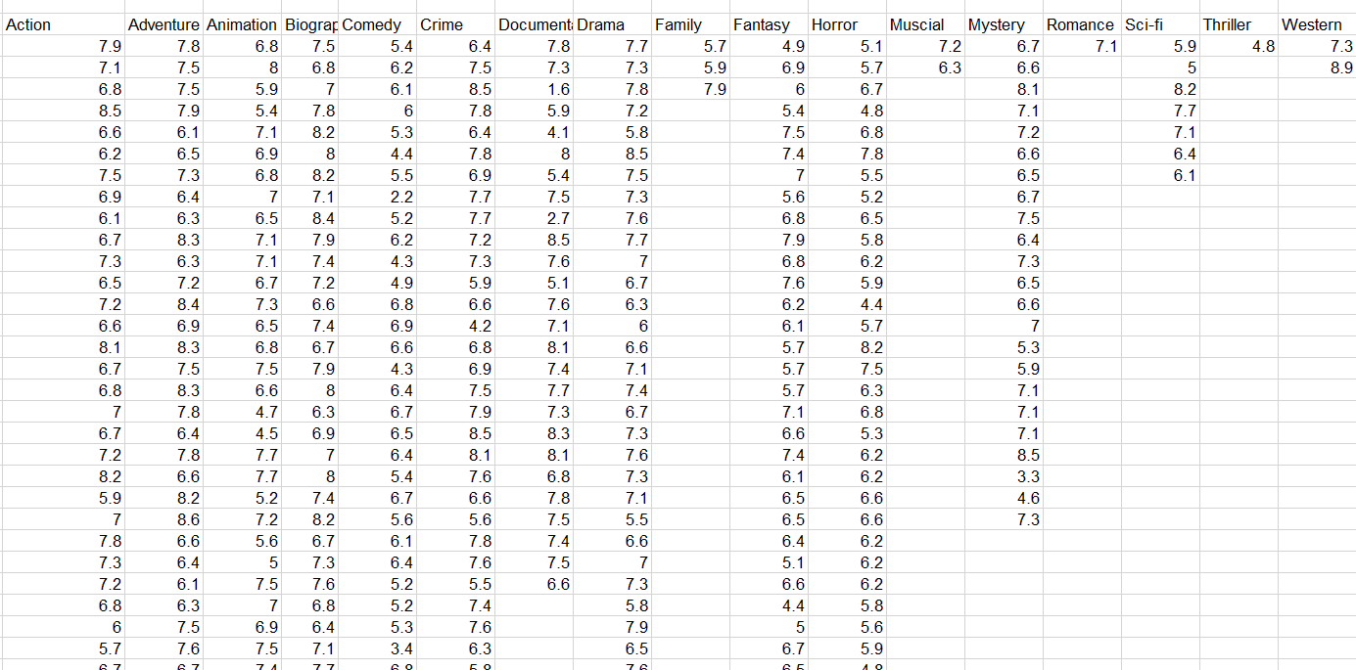
Movie Genre Analysis: Analyzing the distribution of movie genres and their impact on the IMDB score.
Contd..
I used following formulas:
=COUNTIF(A2:A3757, "Action")
=COUNTIF(A2:A3757, "Adventure")
=COUNTIF(A2:A3757, "Animation")
=COUNTIF(A2:A3757, "Biography")
=COUNTIF(A2:A3757, "Comedy")
=COUNTIF(A2:A3757, "Crime")
=COUNTIF(A2:A3757, "Documentary")
=COUNTIF(A2:A3757, "Drama")
=COUNTIF(A2:A3757, "Family")
=COUNTIF(A2:A3757, "Fantasy")
=COUNTIF(A2:A3757, "Horror")
=COUNTIF(A2:A3757, "Musical")
=COUNTIF(A2:A3757, "Mystery")
=COUNTIF(A2:A3757, "Romance")

Slide 6
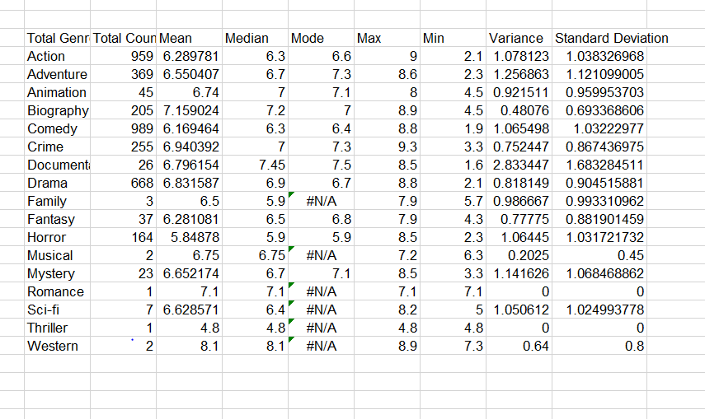
Movie Genre Analysis
Calculating descriptive statistics (mean, median, mode, range, variance, standard deviation) of the IMDB scores:
=AVERAGE(D3:D961)
=MEDIAN(D3:D961)
=MODE(D3:D961)
=MAX(D3:D961)
=MIN(D3:D961)
=VAR.P(D3:D961)
=STDEV.P(D3:D961)

Slide 7
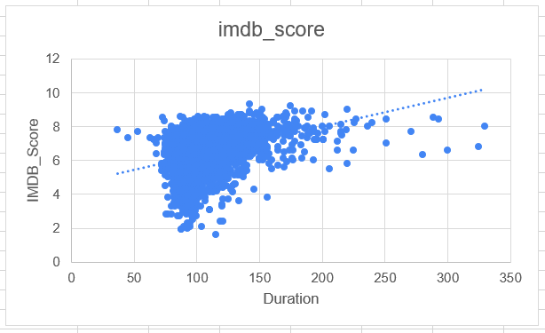
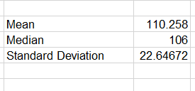
Movie Duration Analysis: Analyzing the distribution of movie durations and its impact on the IMDB score.
I used following formula:
=AVERAGE(A2:A3757)
=MEDIAN(A2:A3757)
=STDEV(A2:A3757)

Slide 8
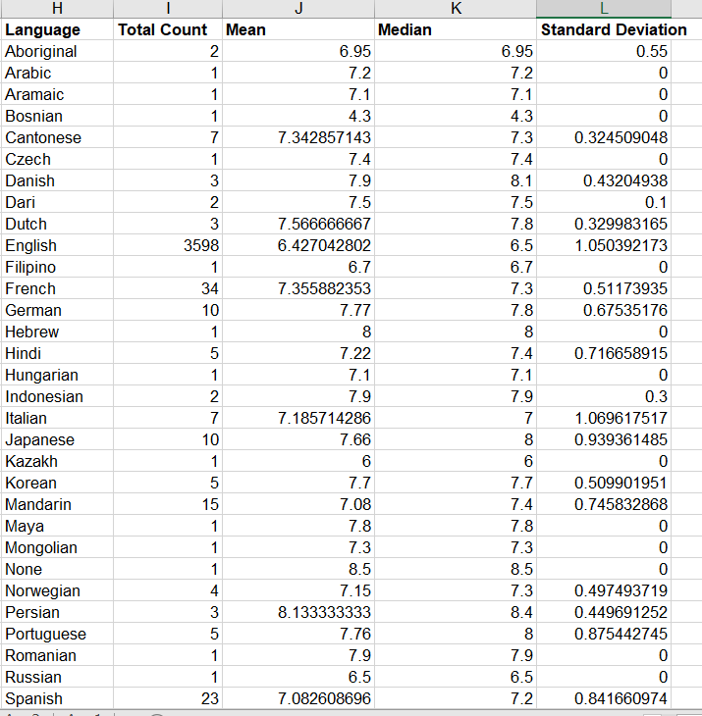
Language Analysis: Situation: Examining the distribution of movies based on their language.
Contd..
I used COUNTIF function to count
the number of movies for each language:
=COUNTIF(A2:A3757, "Aboriginal")
=COUNTIF(A2:A3757, "Arabic")
=COUNTIF(A2:A3757, "Aramaic")
=COUNTIF(A2:A3757, "Bosnian")
=COUNTIF(A2:A3757, "Cantonese")
=COUNTIF(A2:A3757, "Czech")
=COUNTIF(A2:A3757, "Danish")
Like this we find the number of movies for each language.

Slide 9
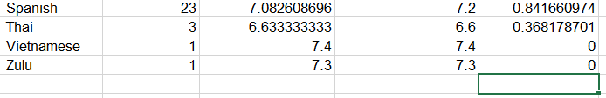
Language Analysis:
The mean, median, and standard deviation of the IMDB scores for each language:
Mean =AVERAGE(N4:N5)
Median =MEDIAN(N4:N5)
Standard Deviation =STDEV.P(N4:N5)

Slide 10
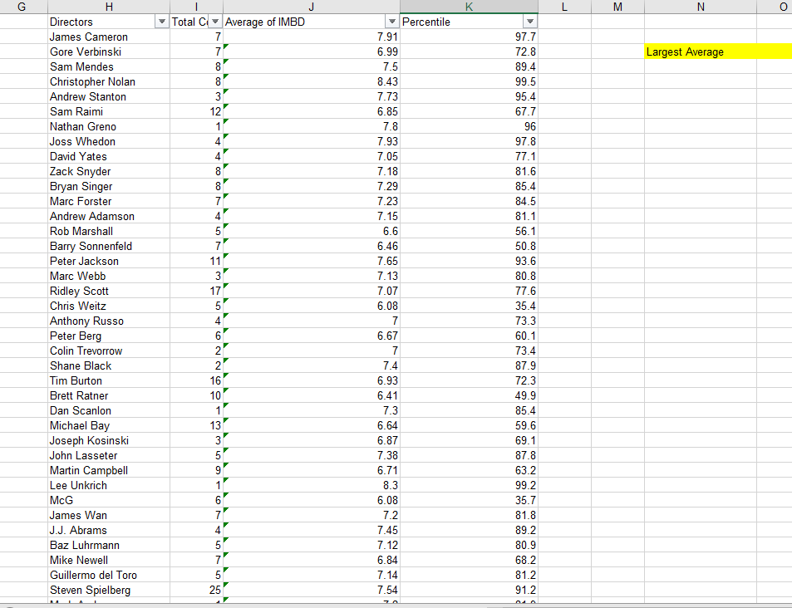
Director Analysis: Influence of directors on movie ratings.
Contd..
To find the top directors based on their average IMDB score I used a countif function.
=COUNTIF(A2:A3757, H2)
To identify the directors with the highest scores
I used the percentile function:
Firstly, I found the largest average IMBD
Score.
=LARGE(B4:B1663,1)
=ROUND(AVERAGEIF(A2:A3757,H2,B2:B3757),2)

Slide 11

Director Analysis: Influence of directors on movie ratings.
Then comparing the scores of these
directors to the overall distribution of scores.
=PERCENTRANK.INC(J2:J1660, J2)*100

Slide 12
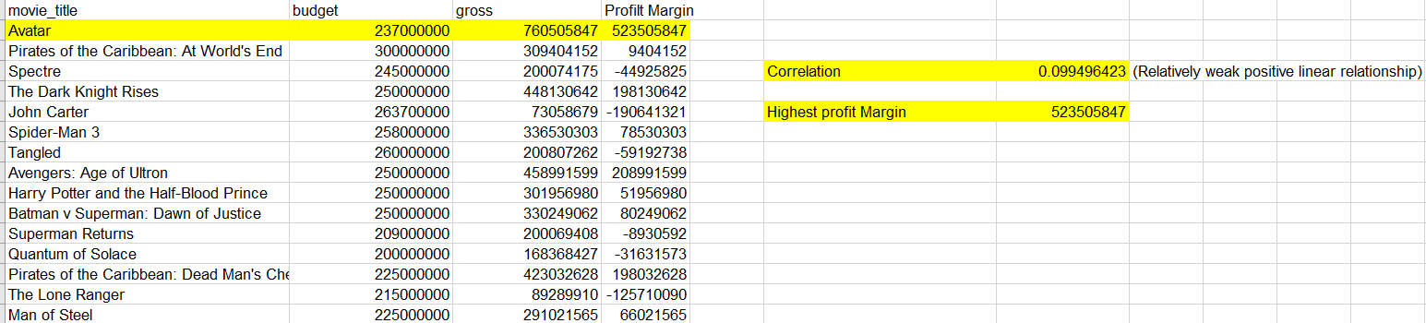
Budget Analysis: Explore the relationship between movie budgets and their financial success.
The correlation between movie budgets and gross earnings is showing relatively weak positive linear relationship
=CORREL(B2:B3757,C2:C3757)
The movies with the highest profit margin.
=MAX(D2:D3757)

Slide 13
Insights
The most common movie genre is comedy.
We found that movie with duration 100-120 minutes has maximum number of movies, but the average IMBD is highest for 221-240 minutes. The highest median IMBD is in 281-300 minutes.
The most common languages used in movies is English.
The percentile rank of average IMBD is highest of “Akira Kurosawa”. But since he has made only one movie so this won’t be appropriate means of analyzing.
The maximum profit is of “Avatar” movie and it has highest profit margin around 523505847.

Slide 14
RESULT
This project helps in analyzing the distribution of movie genres and their impact on the IMDB score, the distribution of movie durations and its impact on the IMDB score. Moreover, the most common languages used in movies is English and their impact on the IMDB score. Also, the relationship between movie budgets and their financial success.
For more details you can visit excel, please click here

Slide 15
Thank You!

